Slide 1
Child/Adult Learner
“ Learning is a treasure that will follow its owner everywhere”
Chinese proverb

Slide 2
Pedagogy and Andragogy
The terms “andragogy” and “pedagogy” are of Greek origin, both including the Greek verb “ago:”
Which means “guide”, and the Greek words:
“andras” (man) and “paidi” (child). Thus =:
Pedagogy = paidi (child) + ago (guide)
Andragogy = andras (man) + ago (guide)

Slide 3
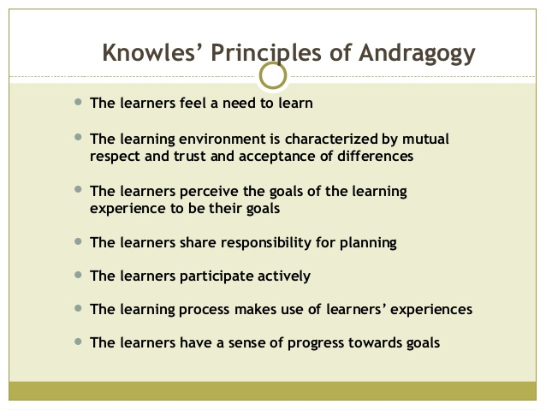
Knowles’ Principles of Andragogy

Slide 4
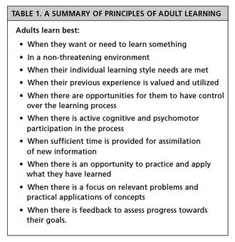
Principles of Learning Cont.

Slide 5
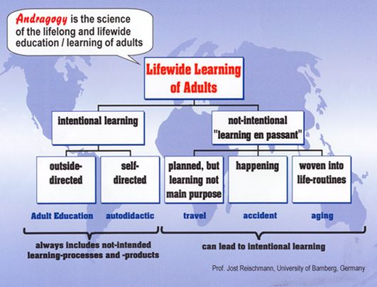
What is Andragogy?

Slide 6
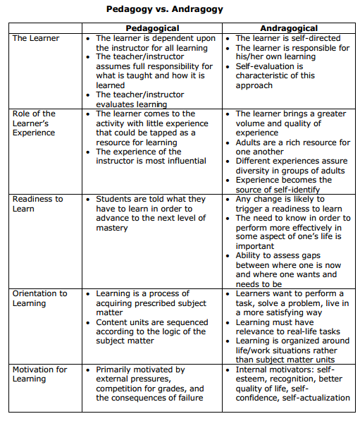
Pedagogy VS Andragogy

